Slide 1

POSTER DESIGN WORKSHOP
2025 Student Research Week

Slide 2
Workshop Structure
Our agenda
  General poster requirements.
  Poster examples
  Sources to generate poster.
  Presentation tips - presenting to broad and specialized audiences.

Slide 3
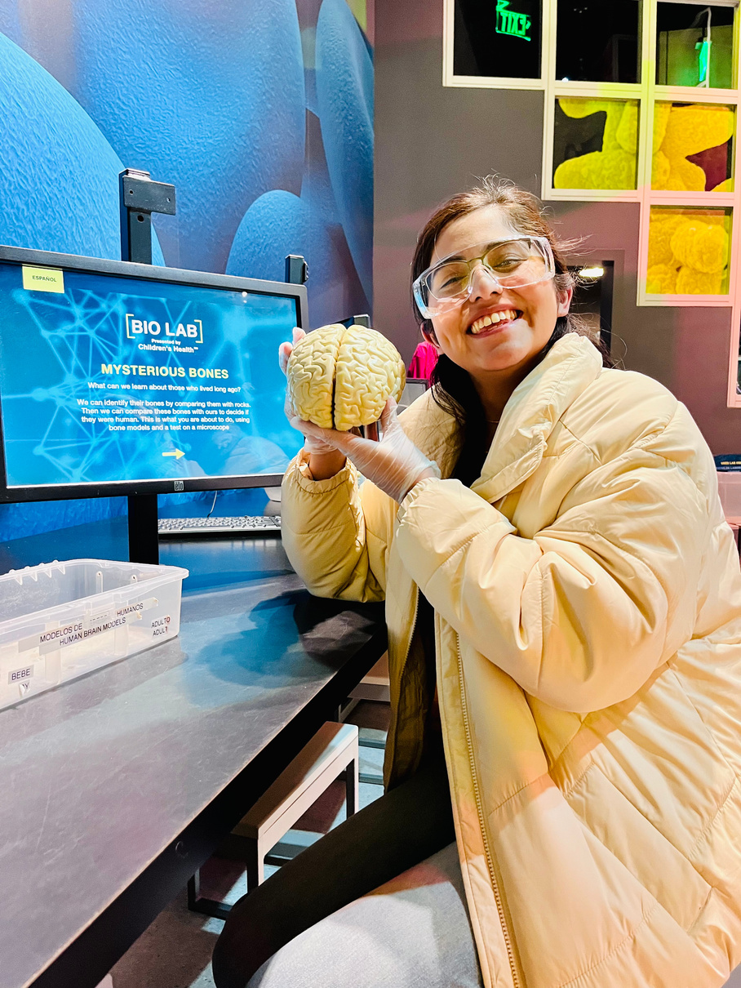
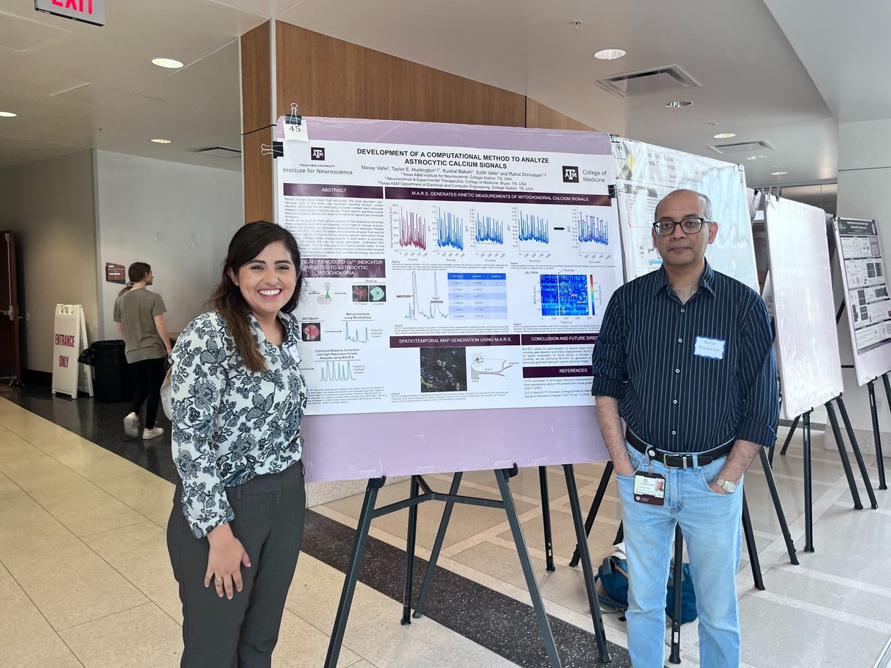

About Me
B.S. in Neuroscience from Texas A&M.
Involved in scientific research since freshman year of college.
Presented my first poster sophmore year.

Slide 4



Look cool AND win money!
You are making an impact in the world!
Research allows for improvement, innovation and discovery. Look around you! Every single thing that surrounds you is here because of research.
  How do I share all my cool and important projects with the world?

Slide 5

Let's create a poster!
Average size: 36x48 inches
What should it include: Project title, abstract, objectives, methods, results, conclusion.

Slide 6


Slide 7


Slide 8


Slide 9


Most common software used to design posters. You can use template uploaded to the Call for Abstract document
Publisher is also a great way to design a poster! It has more graphic options than PowerPoint.

Slide 10


bioRender is commonly used for article figures and it also has a poster design mode! IT IS FREE! Margins are hard to edit.
If you have an account, Adobe Illustrator is also a great choice.

Slide 11

POSTER PRESENTATION TIPS
KNOW YOUR PROJECT!
Ask your mentor questions. Read a paper about the issue.
Your presentation should feel like you are telling a story.
It must follow a cohesive order and you should be confident enough in what you've learned so far.
  Doesn't mean you have to be an expert, but do know why you are doing what you're doing.

Slide 12
Write down a script days in advance
Do not memorize it word by word
You can create more than 1 version
Rehearse it!
Test out your script with both an expert in the field and a member of general public.
The script is meant to consolidate your ideas into an easy to follow speech.
You can tailor your speech to the different types audience you can expect.

Slide 13

Video Requirements
Content
Format
Research purpose
Methods
Findings
Impact
Use Zoom or another video recording tool
Upload to YouTube as an unlisted video
Include the YouTube link in your submission form

Slide 14

SHOW WHY YOU'RE PROUD OF YOUR PROJECT
At the end of the day, a poster presentation is an opportunity to teach people why what you do is amazing!

Slide 15

Thank you for attending!
Questions?

